Slide 1
Wikidata.lib
BP2013N2
InfoLunch 04.06.2014

Slide 2
Wikidata.lib
Wikidata
Property Suggestions
Value Suggestions
Edit Item Page
Evaluation
Hackathon
BP N2

Slide 3




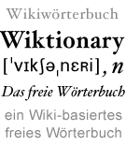
Wikidata

Slide 4
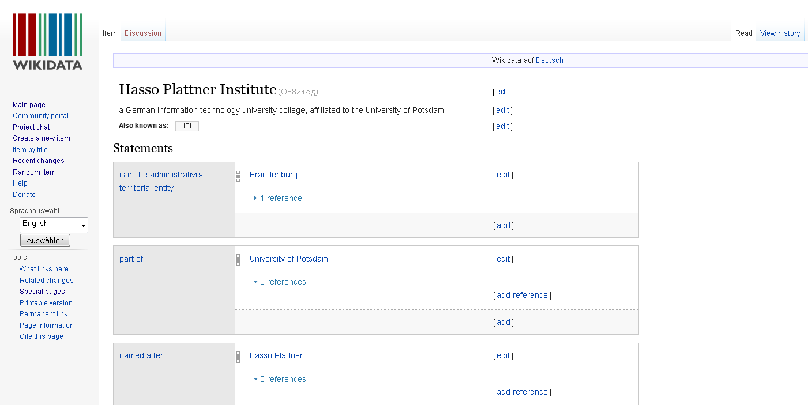
Wikidatas Content: Items

Slide 5
„Statement“ = Property + Value
Recorded and maintained by bots and Wikidata-Users: „Community“

Slide 6
Vision & Goals
Create a common data repository
Support other Wikimedia projects, e.g.. Wikipedia
Centralizing language links
Providing a central place for info box data for all Wikipedias
Creating and updating list articles based on data in Wikidata

Slide 7
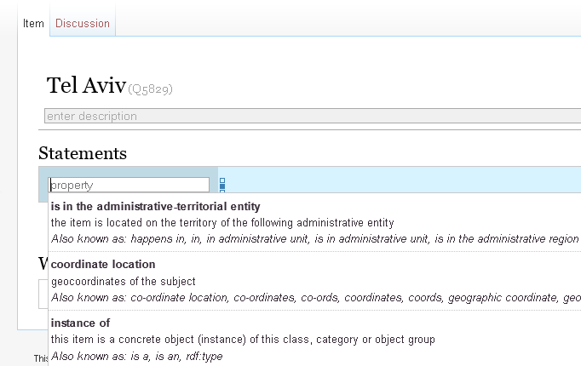
Achievement 1: Property Suggestions
Suggestions

Slide 8
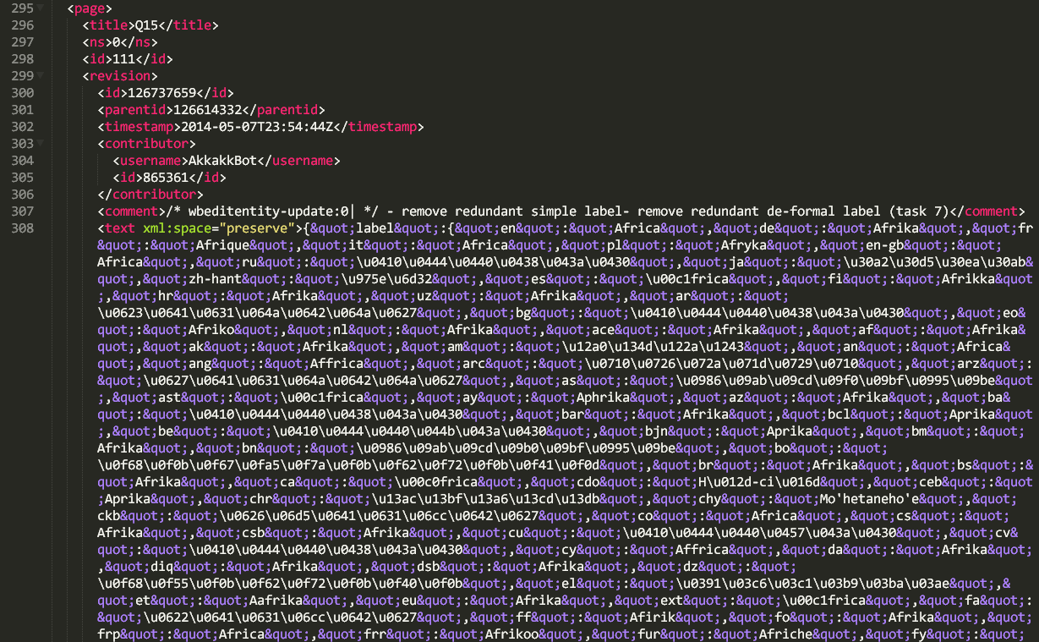
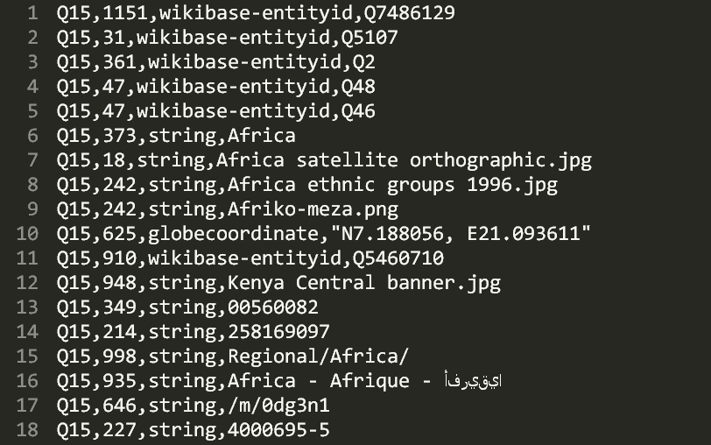
Dump parsing
Wikidata „Pages“ Dump: XML and Json
Reduction and conversion into CSV:
All statements: „subject – predicate – object “ = „Item – Property – Value“
Wikidata DUMP
CSV

Slide 9
Analysis
x
 | 1 | 2 | 3 | 4 | 5 | 6 | 7 | 8 | 9 | 10 | 11
1 | / | 0.2 | 0.4 | / | 0.1 | / | 0.2 | 0.3 | / |  | 0.6
2
3
4 | / | 0.4 | 0.5 | / | 0.7 | / | 0.1 | 0.4 | / |  | 0.5
5
6 | / | 0.8 | 0.9 | / | 0.1 | / | 0.1 | 0.4 | / |  | 0.1
7
8
9 | / | 0.5 | 0.1 | / | 0.2 | / | 0.9 | 0.7 | / |  | 0.1
10
11
y
Count property occurences.
Count property pair occurences.
Calculate:
P(„property x appears in an item whenever property y does“)
CSV

Slide 10
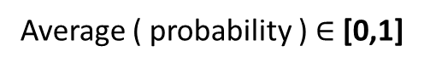
Ranking
Contemplated properties
 | 1 | 2 | 3 | 4 | 5 | 6 | 7 | 8 | 9 | 10 | 11
1 | / | 0.2 | 0.4 | / | 0.1 | / | 0.2 | 0.3 | / |  | 0.6
2
3
4 | / | 0.4 | 0.5 | / | 0.7 | / | 0.1 | 0.4 | / |  | 0.5
5
6 | / | 0.8 | 0.9 | / | 0.1 | / | 0.1 | 0.4 | / |  | 0.1
7
8
9 | / | 0.5 | 0.1 | / | 0.2 | / | 0.9 | 0.7 | / |  | 0.1
10
11
Properties already used in item
score
improvement
…Tf-idf?
Average ( probability ) $∈$ [0,1]

Slide 11
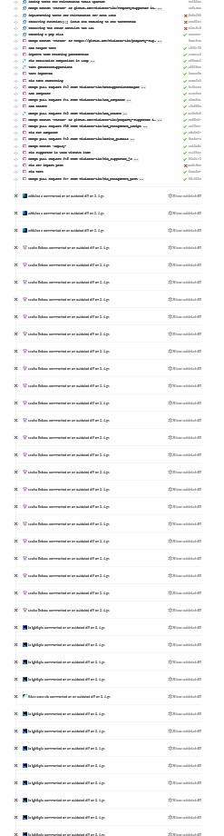
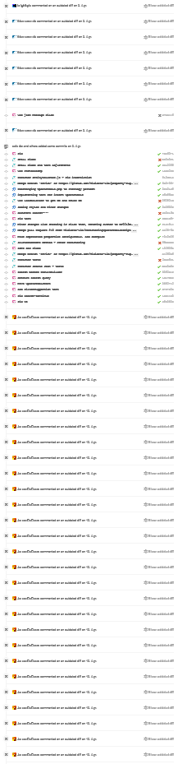
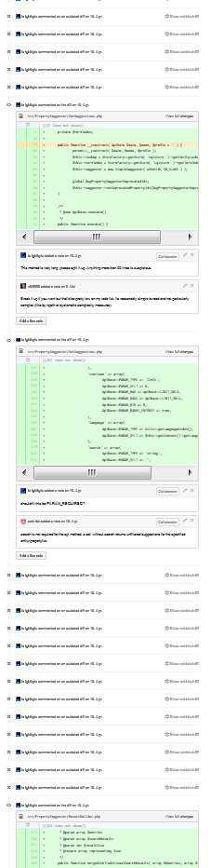
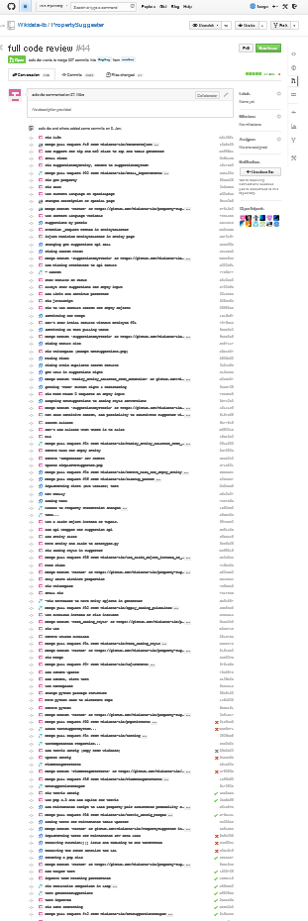
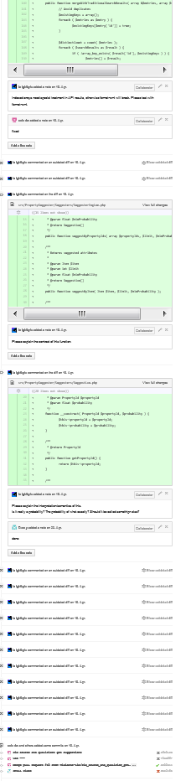

Refactoring
„we'll go ahead and have it
deployed with the next
Wikidata deployment on
June 10th.”

Slide 12
Improvement
Problem:
Instance of and gender occur often together, because a lot of items are humans.
Instance of occurs with a lot of items with another type, too. Cities, movies, …
Thus we suggest human properties for cities, movies…
Solution:
For each Property p: v(p) = count how many other properties p occurs with
Use P(Property x -> Property y) / v(x)
=> give more weight to more specific properties

Slide 13
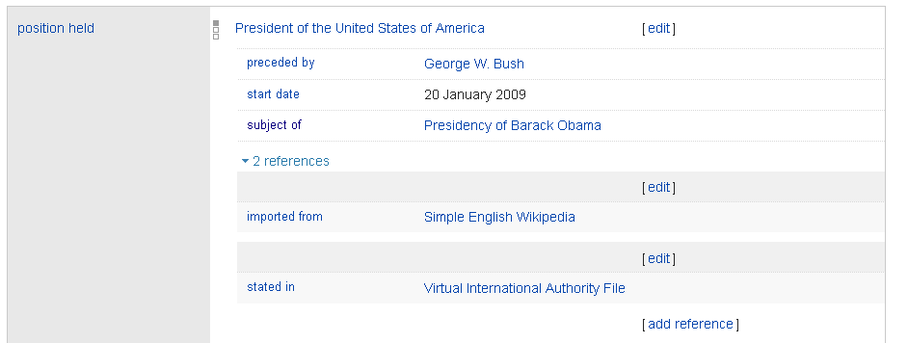
Sources & Qualifiers „Suggestions“

Slide 14
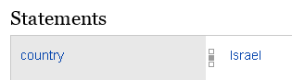
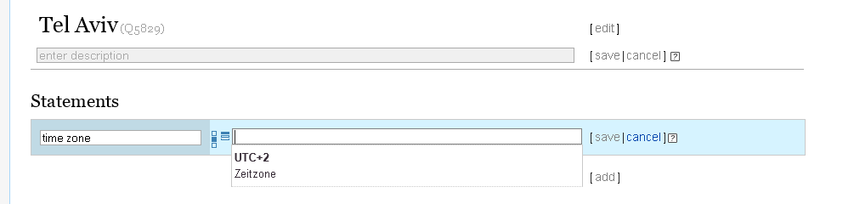
Achievement 2: Item - property dependent item search
WOW!
Magic ;-)

Slide 15
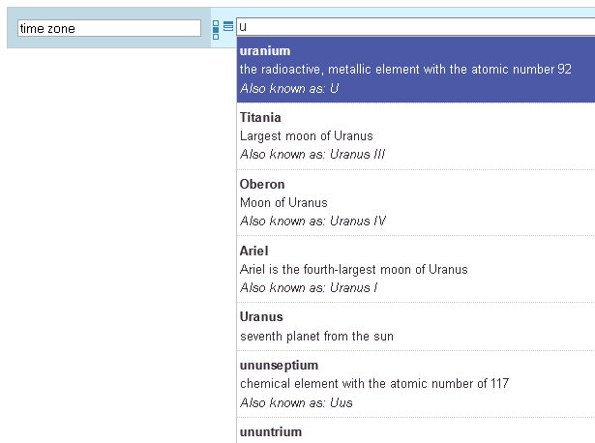
… instead of
Timezone = Uranium,
Titania, Oberon, Ariel,
Uranus, ununseptium,
ununtrium ?

Slide 16
Analysis
Consider Statements with value-type „item“ only.
step1: count statement occurrences
step2: select relevant statements ( #appearance > avg(appearance) x factor )
step3: count statement pair appearances ( only if both statements are “relevant” )
step4: select relevant statement pairs → rules
step5: write to disk
CSV

Slide 17
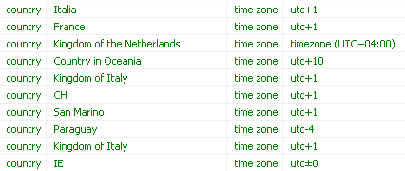


Example rules
Kingdom of Italy?

Slide 18
Achievement 3: Edit Item Page

Slide 19
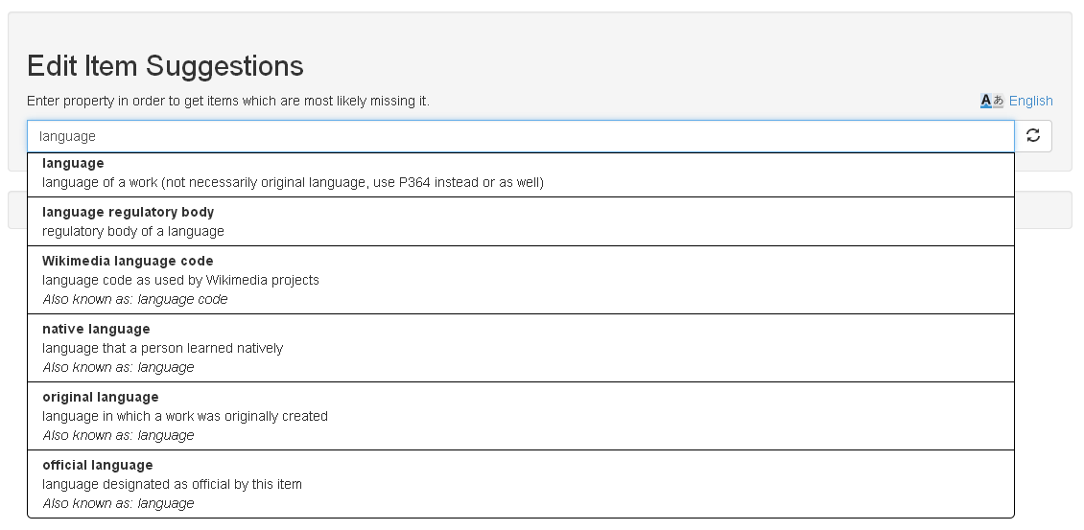
Notes:
Eigenschaft eingeben
Items, wo die Eigenschaft fehlt

Slide 20
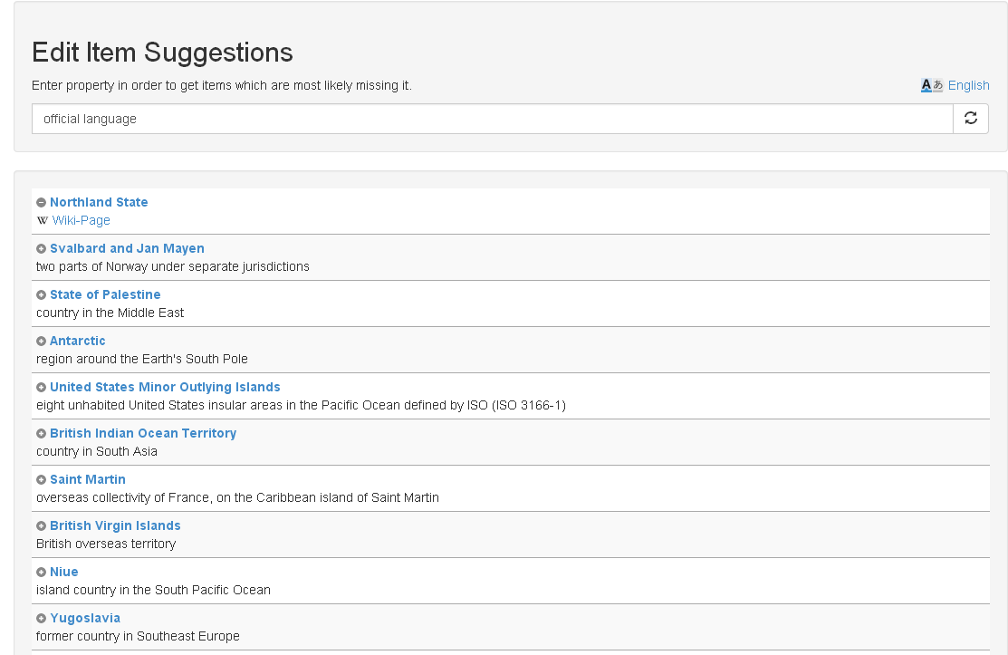
Notes:
Nach 10 min check ob es eingetragen wurde
Verschwindet von Website
Wikipedia Link
Direktes Eintragen
Gute Resonanz auf Wikidata mailingliste

Slide 21
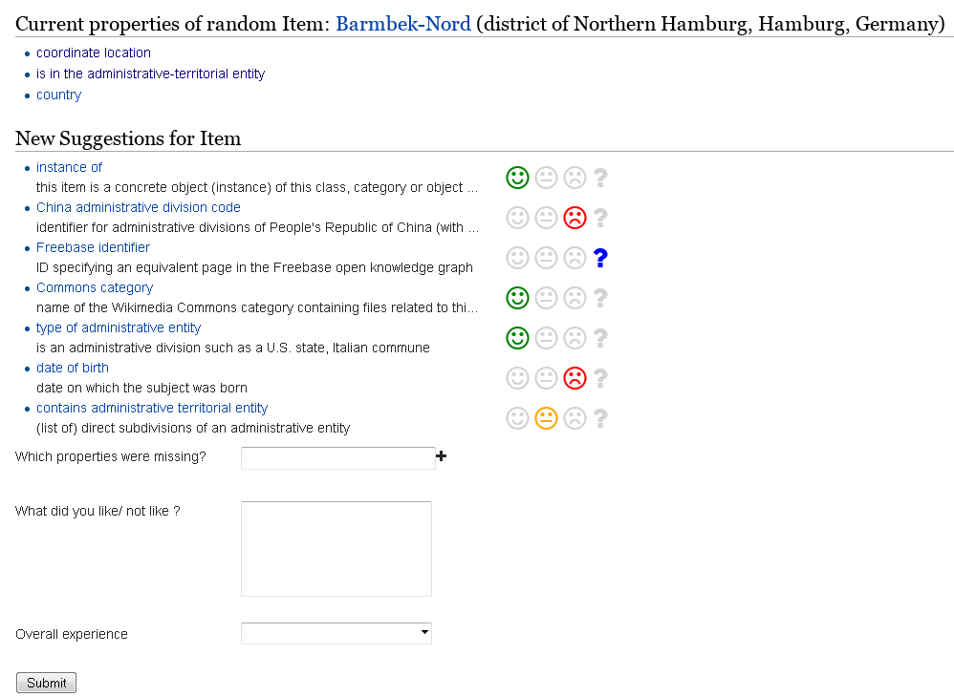
Evaluation

Slide 22
Algorithm
Random Item
Suggester
Property 21
Property 33
Property 8
Property 4
getSuggestions
compare
result
Property 15
Property 4
Property 38
Property 24

Slide 23
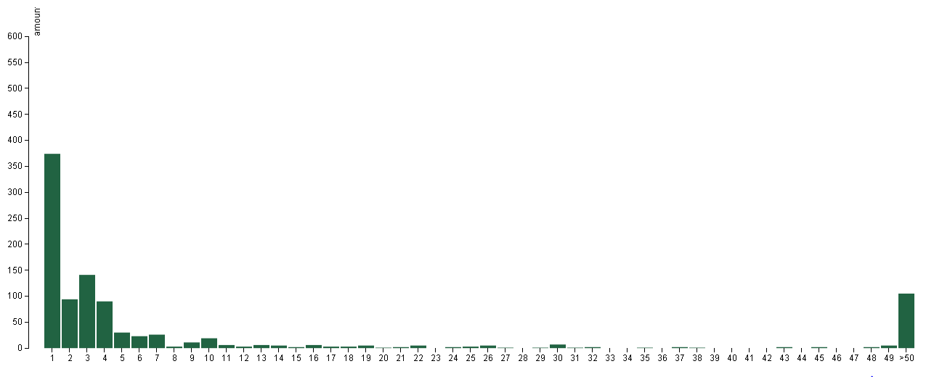
Results

Slide 24
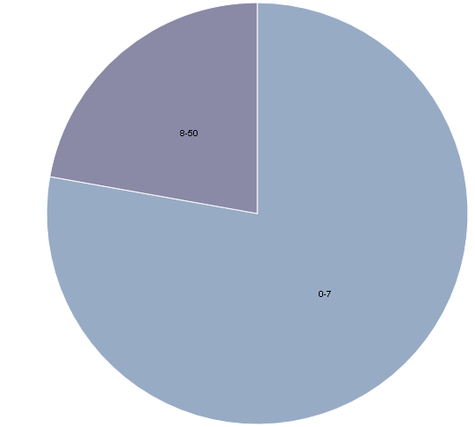
Distribution
8-50
1-7

Slide 25
First letter Algorithm
Random Item
Suggester
Property 21
Property 33
Property 8
Property 4
getSuggestions, search= firstLetter
compare
result
Property 15
Property 4
Property 38
Property 24
Notes:
Extended algorithm:
Provide first letter of missing property as search parameter for suggester
Use Case: User is starting to type

Slide 26
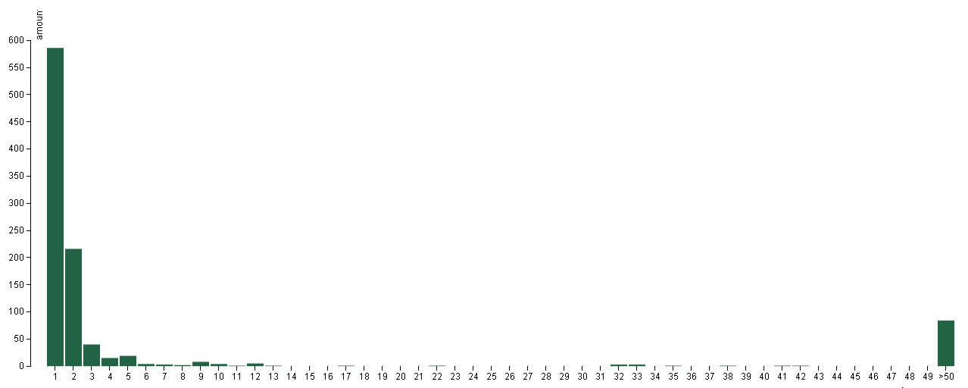
First letter evaluation

Slide 27
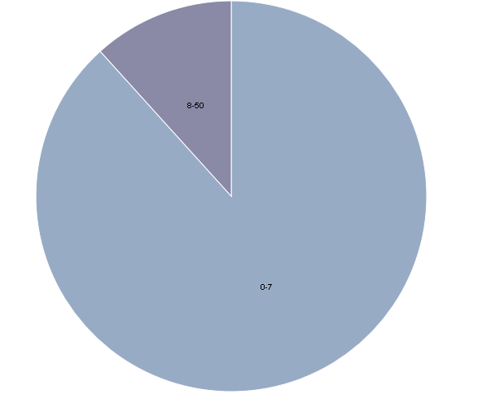
Distribution
8-50
1-7
Notes:
Blau: 1-7
Evaluator
Python
Modular structure to easily extend existing implementation
Visualization
d3.js
bar chart and pie chart
processes csv file

Slide 28
User Feedback Evaluation
User feedback
Created a website for feedback
User ranks suggestions
Wikidata mailing list: 100 evaluations
Until now:
29 participants, 309 evaluations
Notes:
Seite zeigen

Slide 29

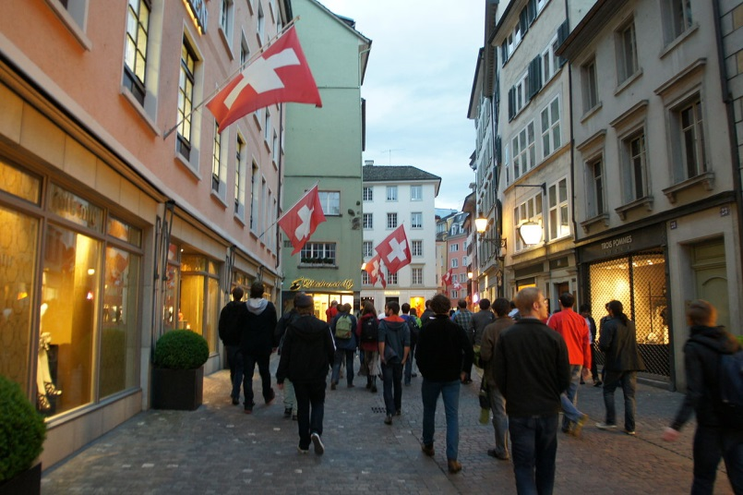
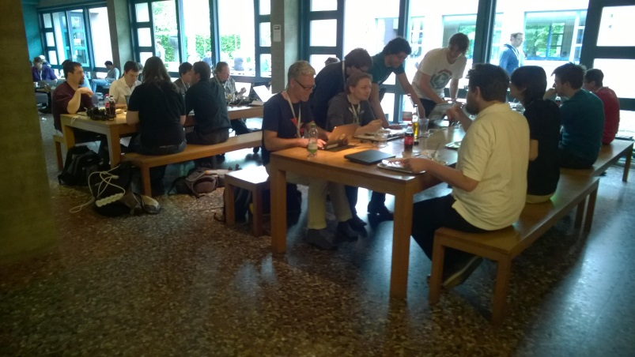
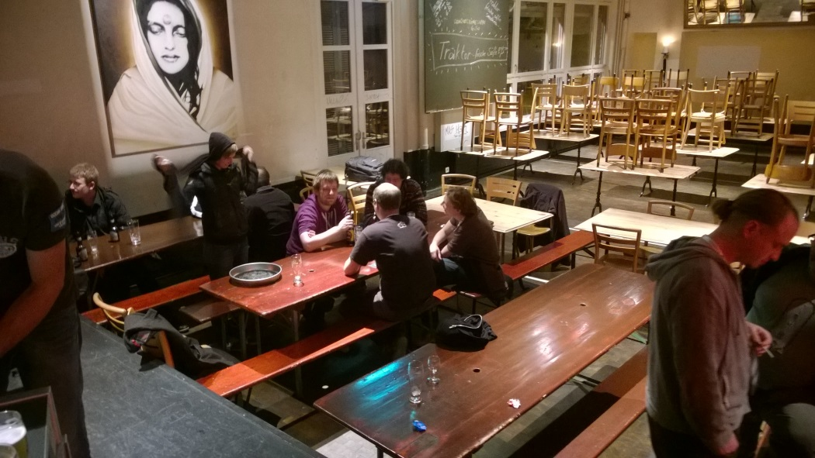
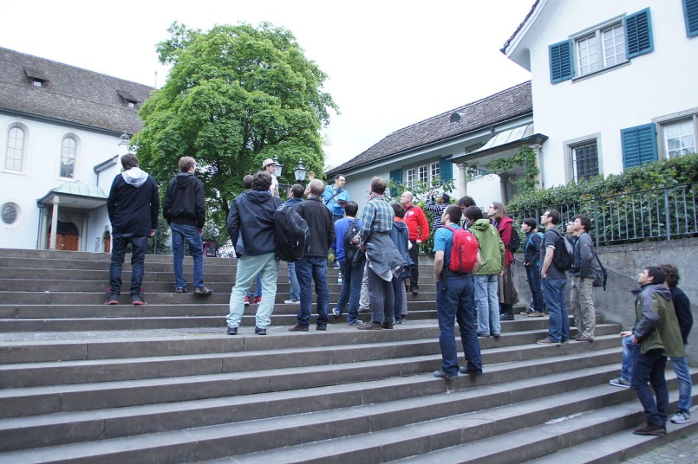
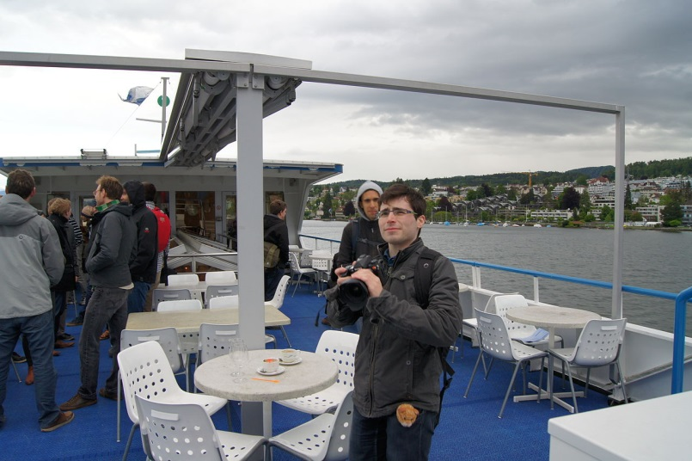
Hackathon Impressions

Slide 30


